Slide 1
Rebel Server Communication System
Senior Design II
Team 12

Slide 2
Team introduction:
We are Team #12 :
Simran Cheema - ITC
Kalen Tullis – CEG
Divyesh Ambaliya – CS
Liliane Owens – CS
Nathaniel Rieder - EE

Slide 3
Table of Contents
Project Goals
Design Approach
Testing
Summary of Results
Conclusions

Slide 4
Project Goals

Slide 5
Design
Wireless data transmission device capable of image recognition and cropping. Communication between transmitter and server is encrypted and over a discrete signal type.
Detect Death Star images and non-Death Star images
Discrete signal type for transmission
Data encryption
Mobile app to display cropped images
Notes:
Nathan

Slide 6
Product
Short-range radio transceiver capable of image identification and data encryption. Images will be viewable on a mobile app hosted by the server
Image recognition created with machine learning
Communication occurs over RF signals
Data is encrypted with AES
Server hosted mobile app
Notes:
Nathan

Slide 7
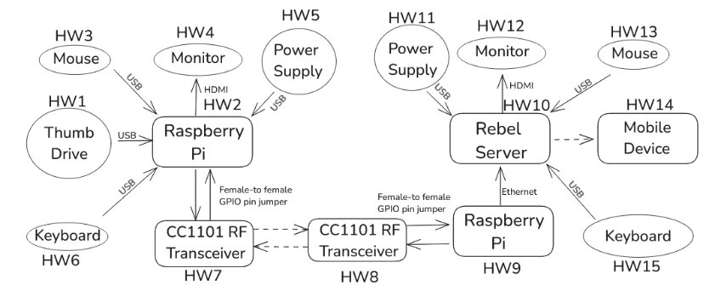
Block Diagram
Notes:
Nathan

Slide 8
Design Approach

Slide 9
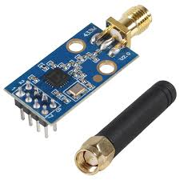
Hardware
Raspberry Pi 4
Highly programmable
Compatible with external hardware
CC1101 RF Transceiver
Operates in short range device frequency bands (sub-1GHz)
Operates at low power
Hardware and software compatible
Notes:
Divyesh

Slide 10
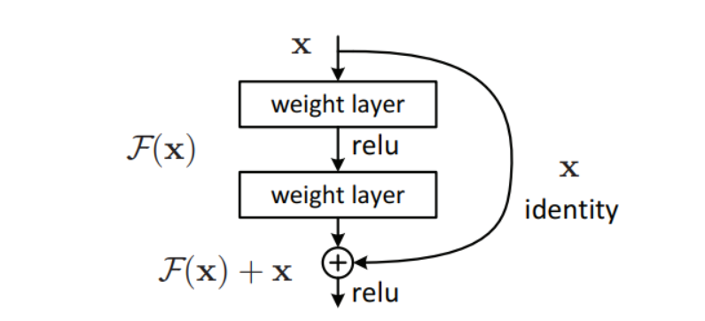
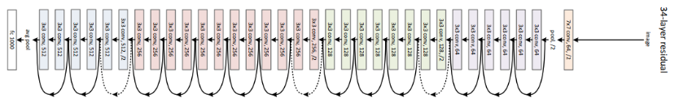
Image Recognition
Residual Network 34
Accurate image recognition
Prevents vanishing gradients
Not too deep for a Raspberry Pi
Built into Pytorch / Torchvision
Notes:
Kalen

Slide 11
Encryption/Decryption
AES
Fast encryption and decryption speed
Operates with 128, 192, or 256 bit key length
Low energy consumption
Notes:
Simran

Slide 12
Testing

Slide 13
Hardware
Raspberry PI 4
Pi can turn on and boot to PiOS
RF CC1101
Setup of devices was done using a setup guide
Once the receiver pi detects the idle transmission of the transmitter the setup is complete
Notes:
Divyesh

Slide 14
Communication
Communication
Verify the receiver receives data packets from our transmitter
Send across an image
Send an encrypted image and verify with checksum
Send ten images within a 10 minute period
Notes:
Simran

Slide 15
Image Recognition
Machine Learning
Software can recognize a Death Star image
Software can recognize a non-Death Star image
Software can determine the ten Death Star images when given a pool of 100
Notes:
Kalen

Slide 16
Encryption/Decryption
AES in ECB Mode
The transmitter can encrypt data
The receiver can decrypt received data
Both will generate a checksum to verify received image is correct
Reason for using ECB Mode:
- Chunk-by-Chunk Encryption: ECB mode allows each 48-byte data chunk to be encrypted independently, which fits perfectly with the way my image data is split and sent via CC1101 in fixed-size packets.
- No Need to Share IV or State: Since ECB doesn’t use an Initialization Vector (IV), I didn’t need to transmit or synchronize extra metadata between the sender and receiver.
Although ECB mode is not ideal for encrypting patterns in larger or uncompressed images due to potential pattern leakage, I compressed and padded the image before encryption, mitigating this risk.
Notes:
Simran

Slide 17
Server
Cropping
Server can crop image
Server can crop images to a red circle in the image
Mobile App
App can display “Hello World”
App can display an image
App can display a grid of images
Notes:
Divyesh

Slide 18
Summary of Results

Slide 19
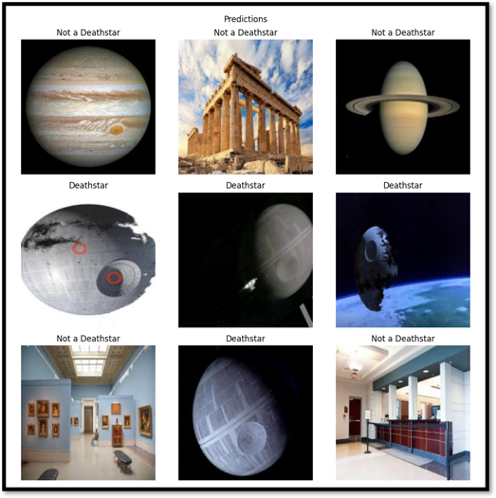
Image Recognition
Program can identify Death Star images from non-Death Star images
Program successfully identified 10 Death Star images and false positive on extras.
Notes:
Kalen

Slide 20
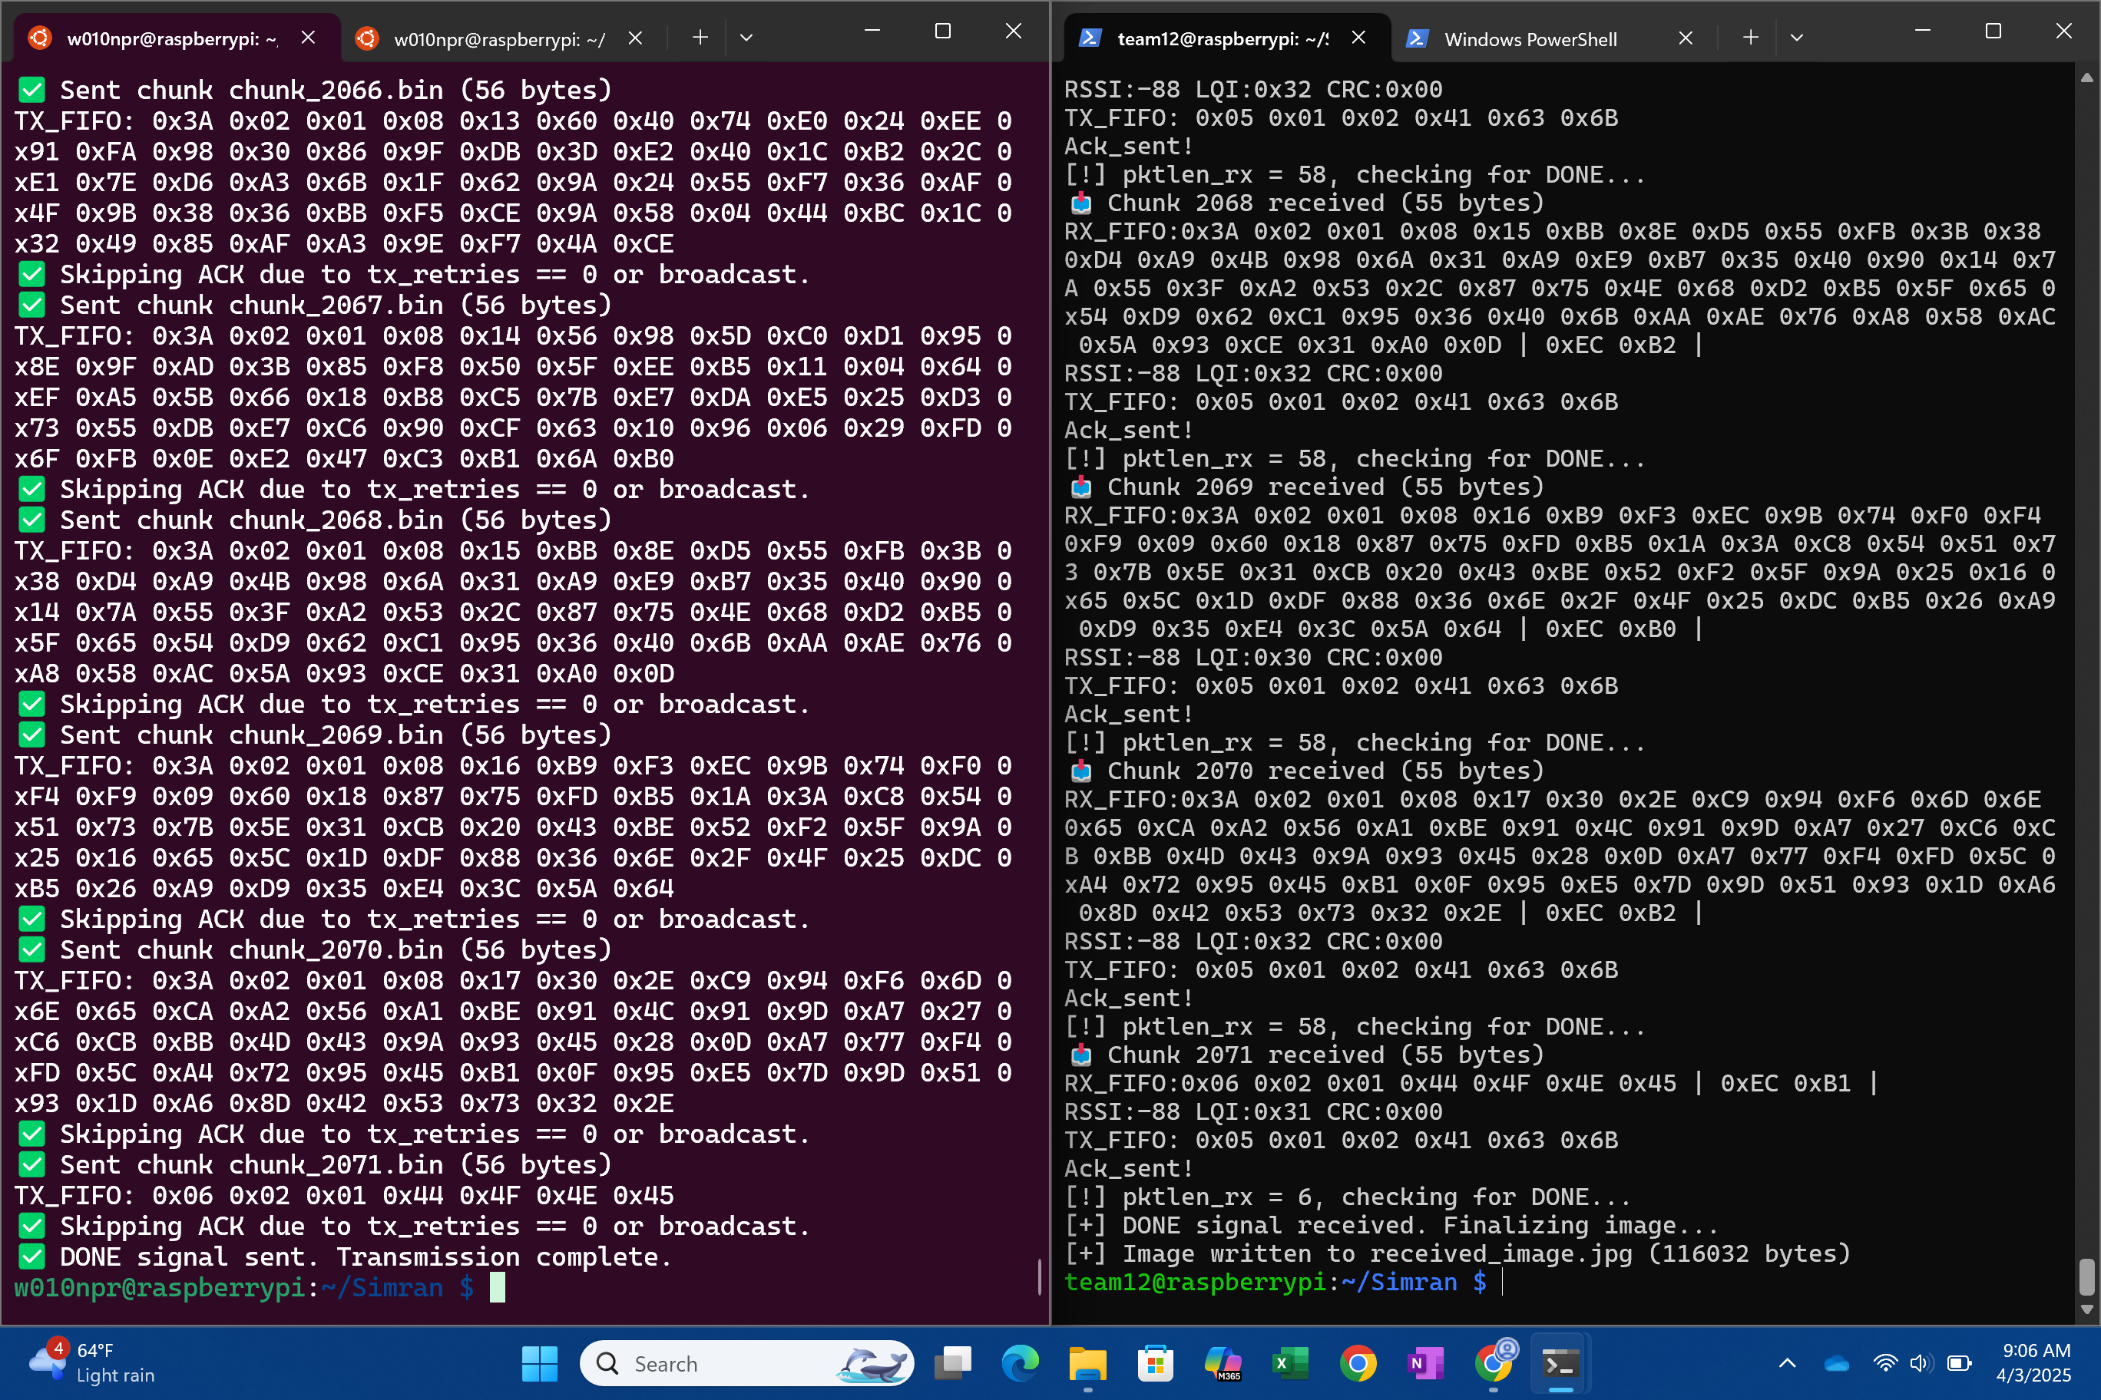
Transmission : All packets sent and received an image file.
Notes:
Simran

Slide 21
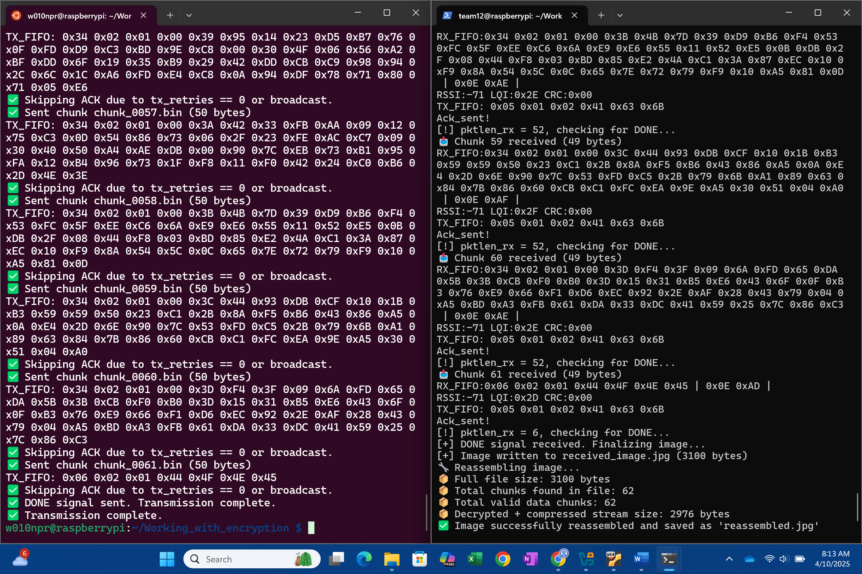
Image transmission worked with Encryption
Notes:
Simran

Slide 22
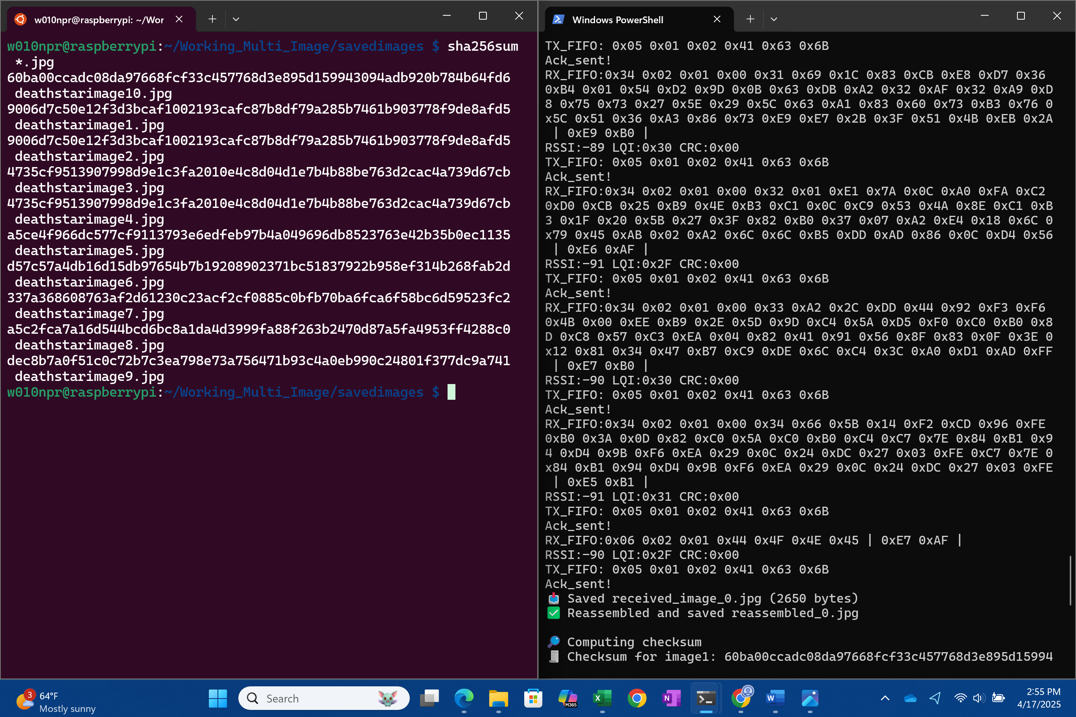
Checksum worked for transmitted image.
Notes:
Simran

Slide 23
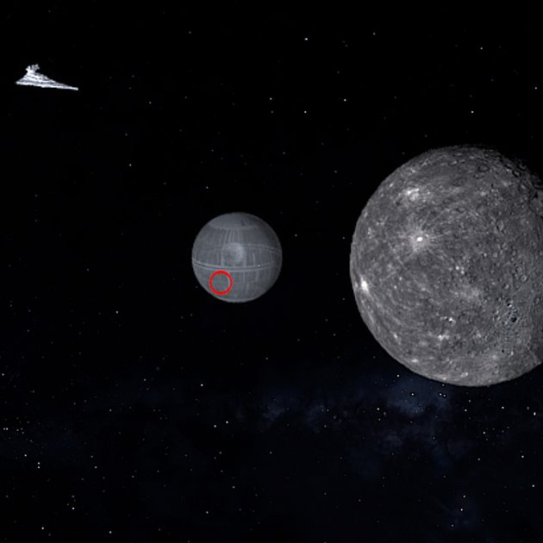


Server
Images are received by transmission and determines checksum
Images are cropped down to the red circle in each received Death Star image
Cropped are saved in a Samba file share and can be viewed on the mobile app
Shared
Notes:
Divyesh

Slide 24
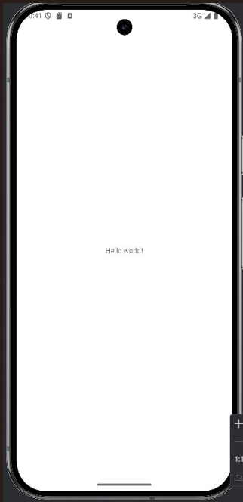
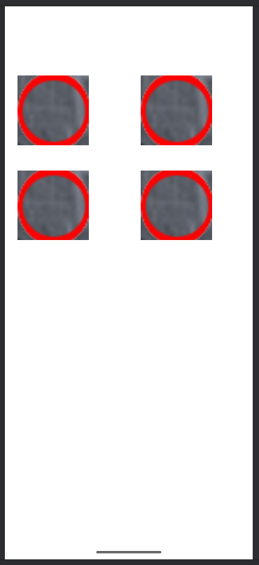
Mobile App
App is launchable on an Android OS device
App is launchable and display the Hello world screen
App displays cropped Death Star images in a scrollable grid
Notes:
Lilliane

Slide 25
Failed Tests
Transmission fails when signal is blocked
Transmission fails when receiver and transmitter are too far apart
Transmission does not fall within the ten-minute time limit
Notes:
Nathan

Slide 26
Conclusions
Successes
Image Recognition
Mobile App
Cropping
Things to change
Transmission Module
Image Recognition Training Time
AWS File Server to access images across different networks
Driver file to encapsulate the scripts
Notes:
Nathan

Slide 27
References
CC1101 Data Sheet
https://www.waveshare.com/w/upload/1/1e/CC1101.pdf
RF chip setup guide
https://www.securipi.co.uk/cc1101.pdf
ResNet Architecture Figure
ResNet
Mobile app
https://www.tutorialspoint.com/android/android_hello_world_example.html

